Slide 1
3D printing for tactile mapping and icons
BLC Virtual Symposium
Friday 22 May 2026
Dr Leona Holloway
Research Fellow, Inclusive Technologies, Monash University
Community Impact Pillar Lead, Monash Assistive Technology & Society (MATS)
Chair, Australia & New Zealand Accessible Graphics Group (ANZAGG)

Slide 2
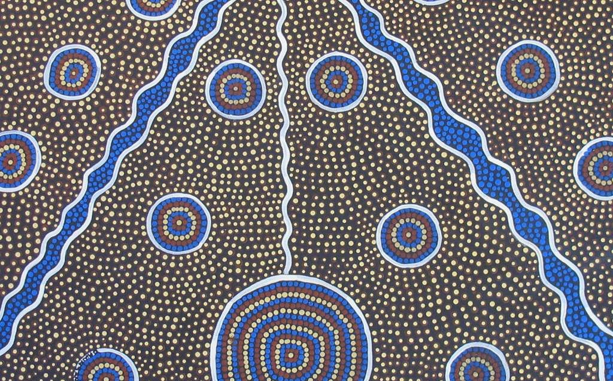
Acknowledgement of Country
I acknowledge the Wurundjeri Woi Wurrung and the Bunurong peoples of the Kulin Nation as the Traditional Owners of the land from which I am joining you near the Maribyrnong River, which translates as “I hear the sounds of the ringtail possum”. I also acknowledge the Traditional Custodians of the various lands on which you are all joining us today.
I recognise the thousands of years old practice of Aboriginal visual storytelling as an important means of passing down cultural knowledge.
I pay my respects to Elders past and present, and welcome any members of indigenous populations who are joining us today.

Slide 3
Beginning the journey

Slide 4
Beginning the Journey of Discovery
1999 first started as a braille transcriber
Involved with Australian Braille Authority and International Council on English Braille
2014 Research into accessible graphics for university students
2015 founded the Australia & New Zealand Accessible Graphics Group (ANZAGG)
2016 Began playing with 3D printing as an accessible format

Slide 5
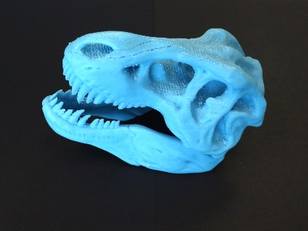
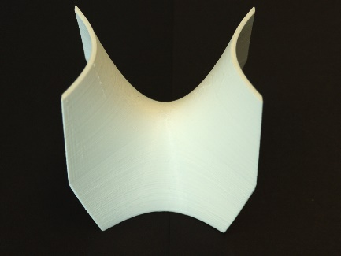
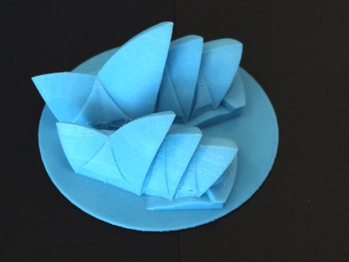
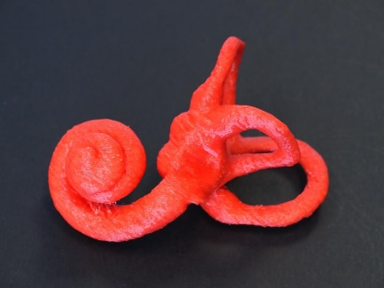
Grab bag study
A wide variety of 3D prints
Are they of interest?
Yes, but …
  We don’t know how to make them yet
  We need evidence to justify investment

Slide 6
3D printing for mapping
Notes:
Tactile literacy and tactile graphicacy

Slide 7
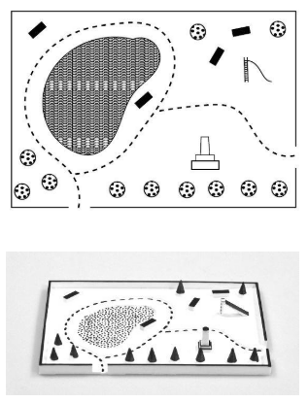
Study 1: Comparative study using maps
Aim: Controlled laboratory study comparing 3D printed maps with equivalent tactile graphics.
Method:
2 sets of park maps & 2 sets of train station maps (imaginary locations)
Counterbalanced order of presentation
Measured time, comprehension and memorability
Observed hand movements
“Accessible maps for the blind”, CHI 2018

Slide 8
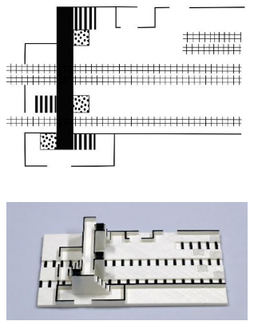
Study 1: Comparative study using maps
Findings:
3D maps easier to understand, especially:
  Recognition of landmarks on the map like stairs, slide, building, chairs
  Understanding of multi-level features (bridge)
Hand movements differ:
  Can’t do a quick lateral scan
  Can place hands flat over the top of the map
  Need to use actions like pinching and enclosure
Need to understand 3D printing process/artefacts
“Accessible maps for the blind”, CHI 2018

Slide 9
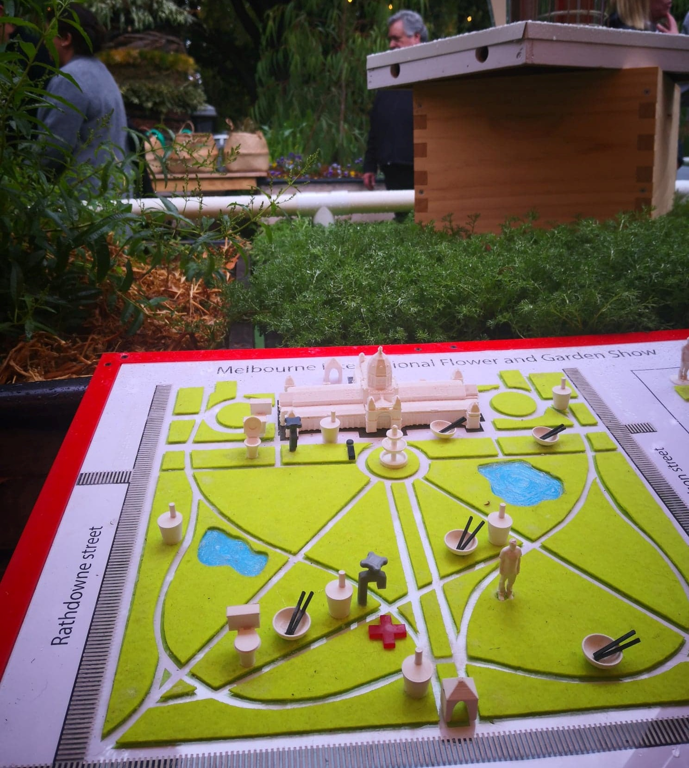
Study 2: Large-Scale Event Map
Context
Melbourne International Flower & Garden Show
100,000 visitors
20 free tickets for Guide Dogs Victoria clients
Materials
“3D printed maps and icons for inclusion”, ASSETS 2019

Slide 10
Study 2: Large-Scale Event Map
Findings
Users:
  Easily used by people with acquired blindness, with no prior experience using tactile media
  Appealing to the general public, serving to raise awareness of accessibility
Usage:
  Wanted a long time to study the map, preferably before arriving on site
  Could be used for wayfinding
“3D printed maps and icons for inclusion”, ASSETS 2019

Slide 11
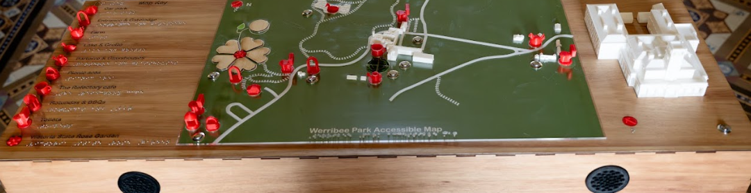
Study 3: Heritage site interactive map
Context
Werribee Park heritage site with expansive grounds and mansion
Touch tour of Werribee Mansion offered but low awareness that accessibility options are available
Materials

Slide 12
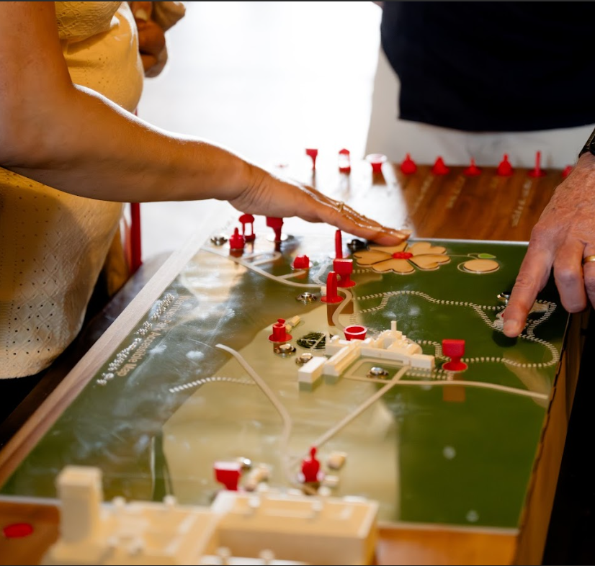
Study 3: Heritage site interactive map
Findings
The map can be displayed in a prominent position because it is appealing and can be used by everyone
It was difficult to use the audio touch buttons in a busy and noisy environment, when tactile strategies become more important
The map enabled BLV visitors to make independent choices about their visit because they knew what was available, relative positions and distances

Slide 13
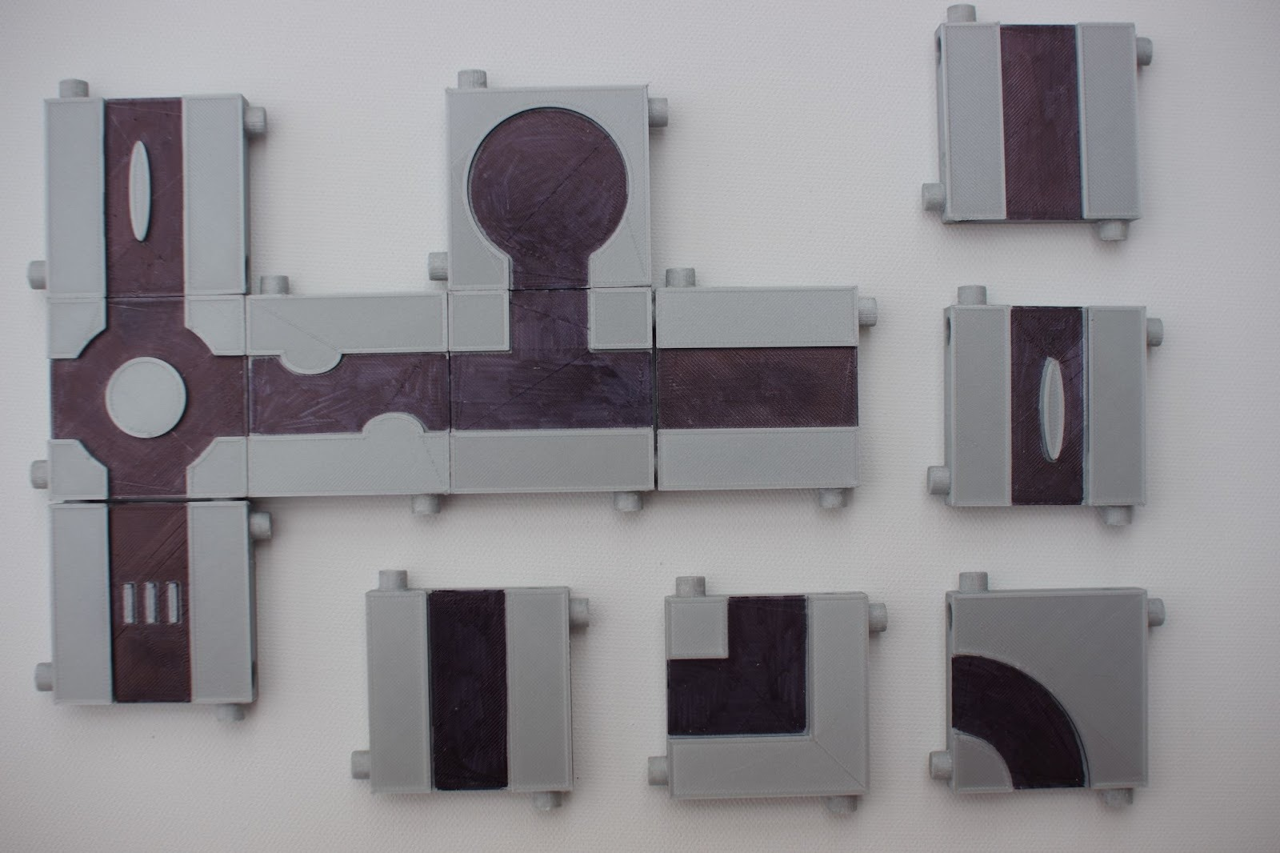
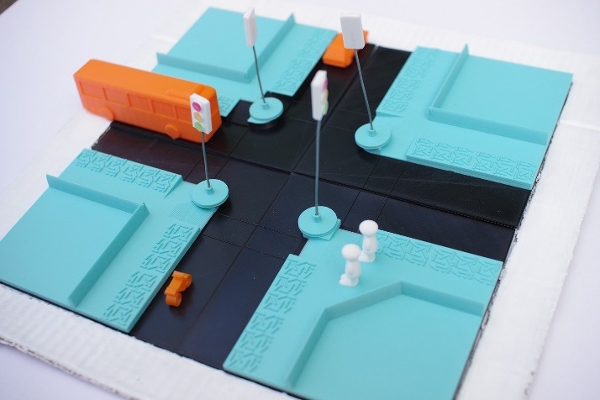
Study 4: Street crossing components
Context
Suggested by O&Ms from Guide Dogs Victoria
Existing tools too expensive/ not appropriate / no longer available
“3D Printed Street Crossings”, CHI 2022

Slide 14
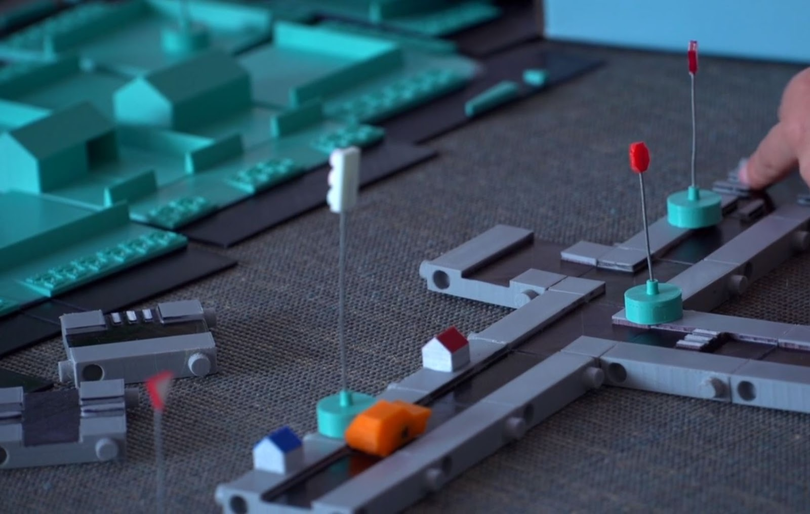
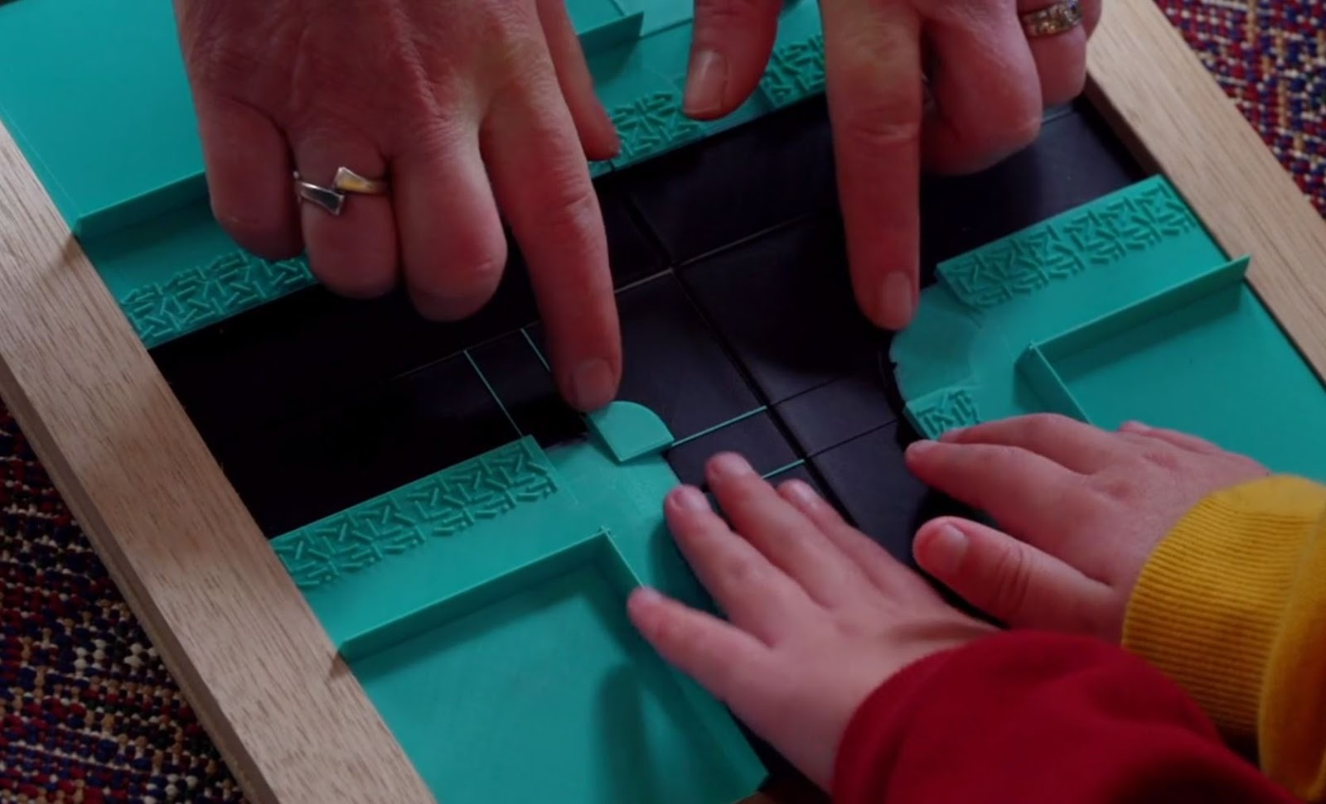
Study 4: Street crossing components
Findings
3D printing is great for creating sturdy manipulatives, which:
  allow for customisation
  are engaging
  allow for more active learning
  can be used to check understanding
“3D Printed Street Crossings”, CHI 2022

Slide 15
TactIcons

Slide 16
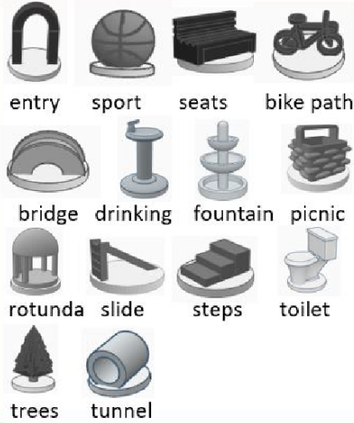
TactIcons development
Aim: Develop a set of rigorously tested tactile icons for sharing
Method:
Co-designed and tested with:
  Congenitally blind touch readers
  Novice touch readers
Output:
33 “recognisable” icons
34 “learnable” icons
Shared on Thingiverse
“TactIcons”, CHI 2023

Slide 17
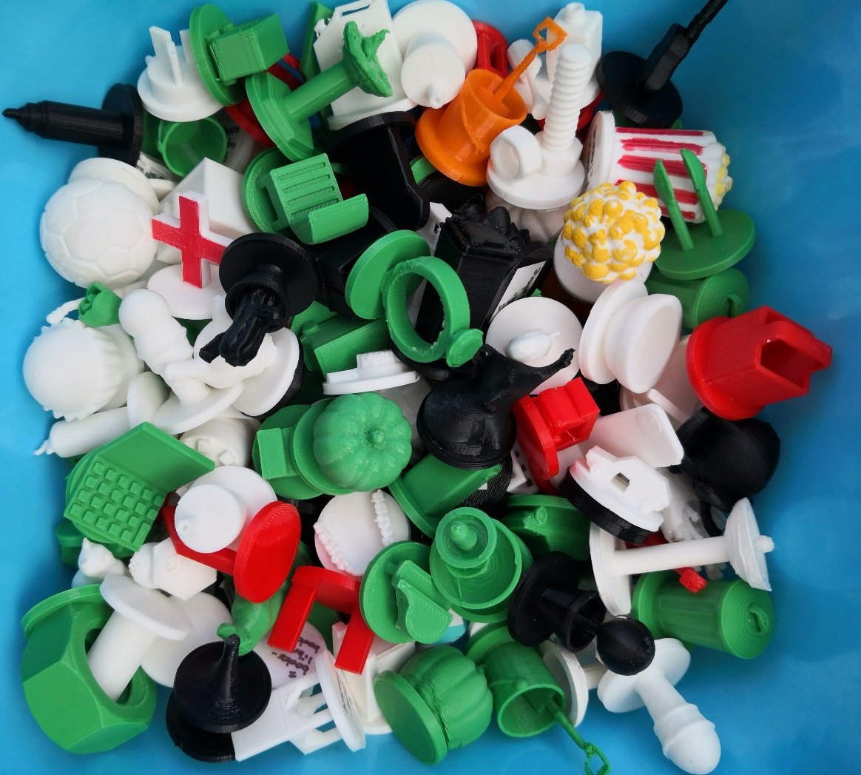
What make a good TactIcon?
Recognition depends on:
1. Being able to feel the object
  Tactile sensitivity
  Use of appropriate hand movements
  Important features near the top of the icon
2. Recognising the object
  Being familiar with the object
  The shape needs to be unique, simplified & realistic
  Scale can be confusing
  Mental imagery
3. Associating the object with the landmark it represents
  Context helps
“TactIcons”, CHI 2023

Slide 18
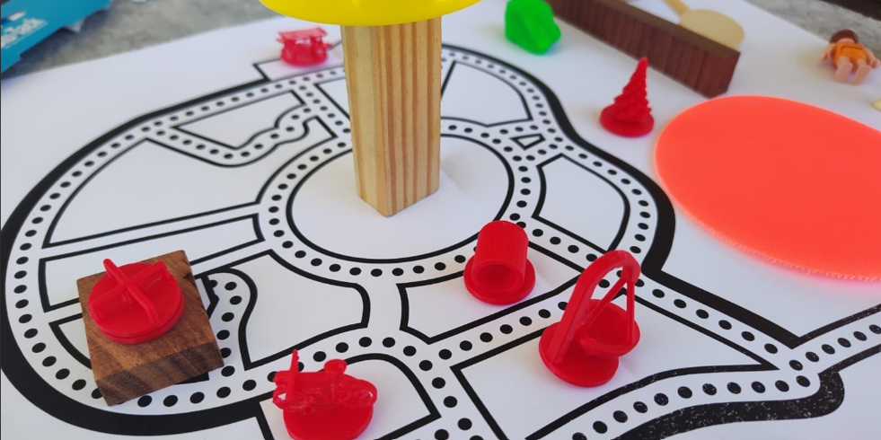
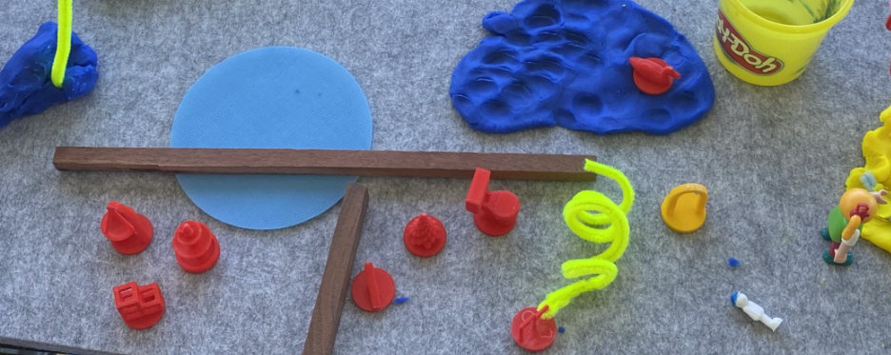
TactIcons on self-made maps
TactIcons are increasingly being used as markers on self-made maps:
Co-created maps are more meaningful
Allows for checking of understanding
Tool for brainstorming and design

Slide 19
What we learned along the way

Slide 20
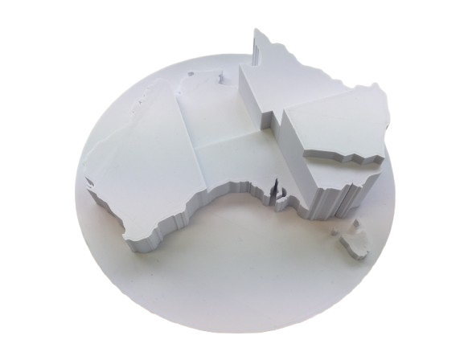
Final study: uses of 3D printing
3D printing is good for:
Representing 3D objects you cannot touch in real life because they are too big / small / dangerous / rare / fragile / expensive
Durable multi-part, moving manipulatives for more
active learning
Inclusive learning tools that are appealing and
accessible to all students
Learning about the translation from 3D object to
2.5D tactile graphic
Creating customised adaptive technology / learning tools
“3D Printing for Accessible Education”, CHI 2025

Slide 21
Final Study: Adoption of 3D printing
Successful adoption (production and use) was supported by:
  Training
  Networking
  Communication within the organisation
  Catalogues and request systems
  Self learning (“give it a go”)
  Organisational support
Non-adopters suffered from small size (lack of flexibility), low technical skills, and isolation
“3D Printing for Accessible Education”, CHI 2025

Slide 22
Emerging tactile media
With advancing technology, there are new ways to make tactile media, e.g.
  UV printing
  Refreshable Tactile Displays
  Haptic devices
This provides exciting new possibilities, but we need to work together to:
  Standardise input formats and production methods
  Reduce the learning curve for easier adoption
  Develop standardised production guidelines to optimise tactile reading
Notes:
Apply to join the ANZAGG RTD SIG https://forms.gle/jjTkbabu3TeMEnhV7

Slide 23
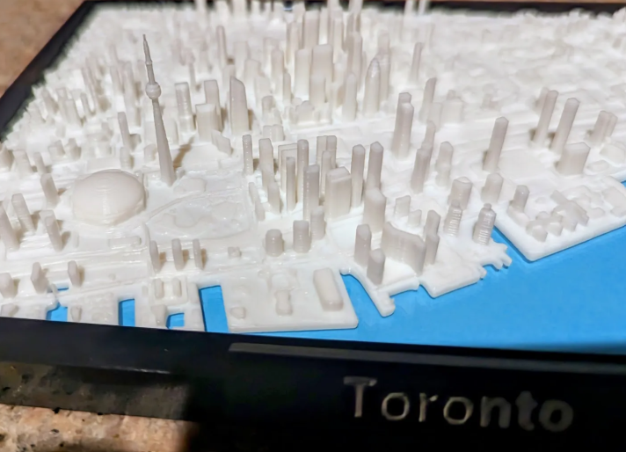
Resources
3D Printing Guidelines
  Round Table https://printdisability.org/guidelines/3d-prints/
Repositories of existing models
Automated tools
  TouchMapper
  Terrain2stl
  Braille-gen
Community Groups
  ANZAGG 3D printing group
  3D for Educators with TSBVI
  Tactile Media Alliance

Slide 24
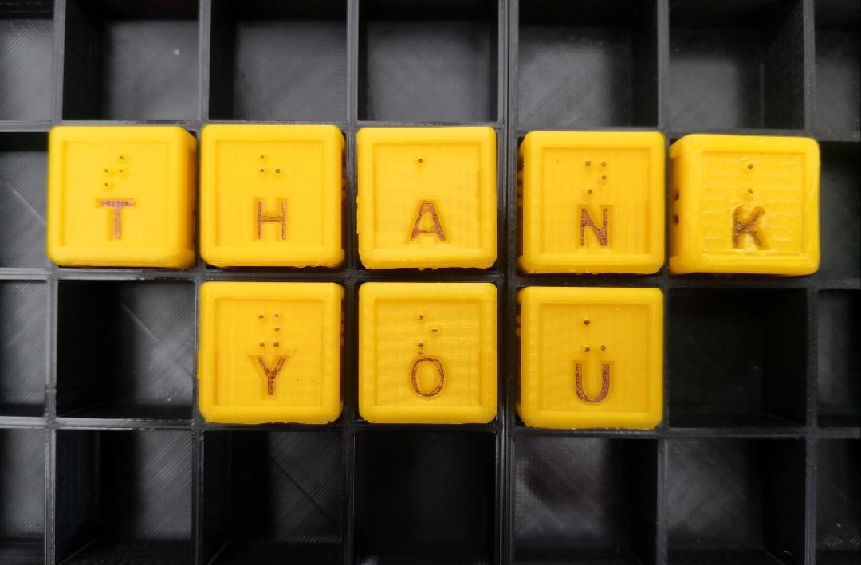
Contacts
Leona.Holloway@monash.edu
Research papers on Google Scholar
ANZAGG https://printdisability.org/about-us/accessible-graphics/
Monash Assistive Technology & Society https://www.monash.edu/mats/

Slide 25
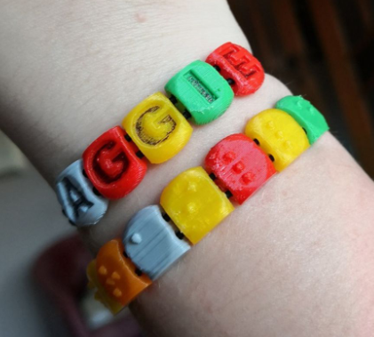
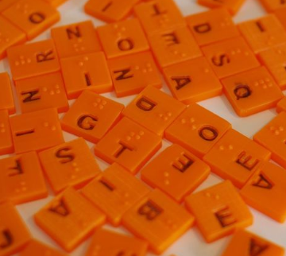
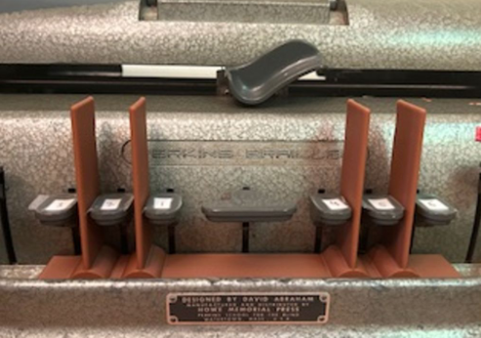
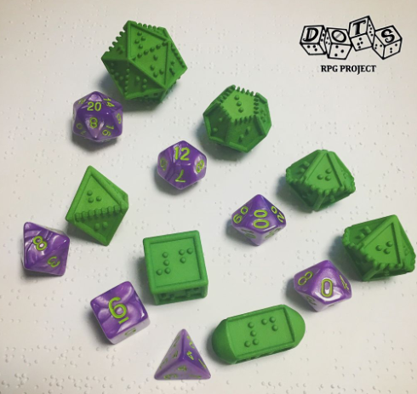
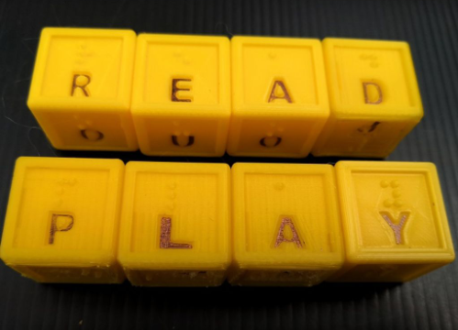
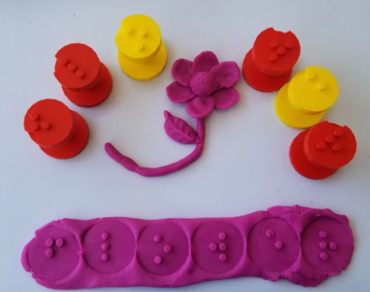
Bonus Content: 3D printing for braille literacy
thing:6767905
thing:4875770
thing:4692311
thing:4908196
thing:4919848
thing:2836494

Slide 26
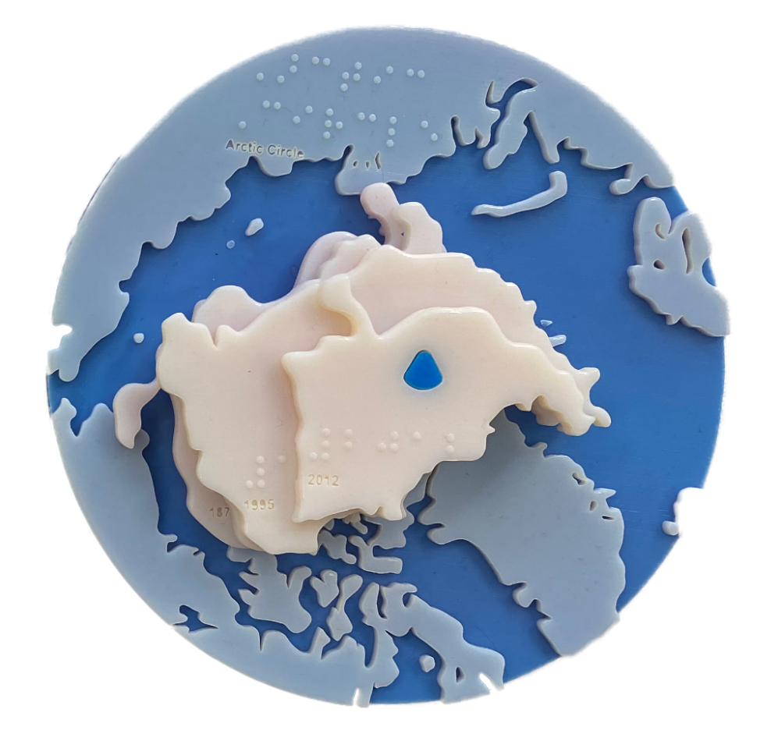
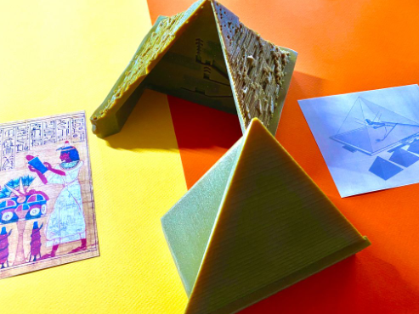
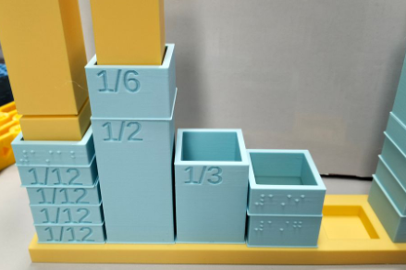
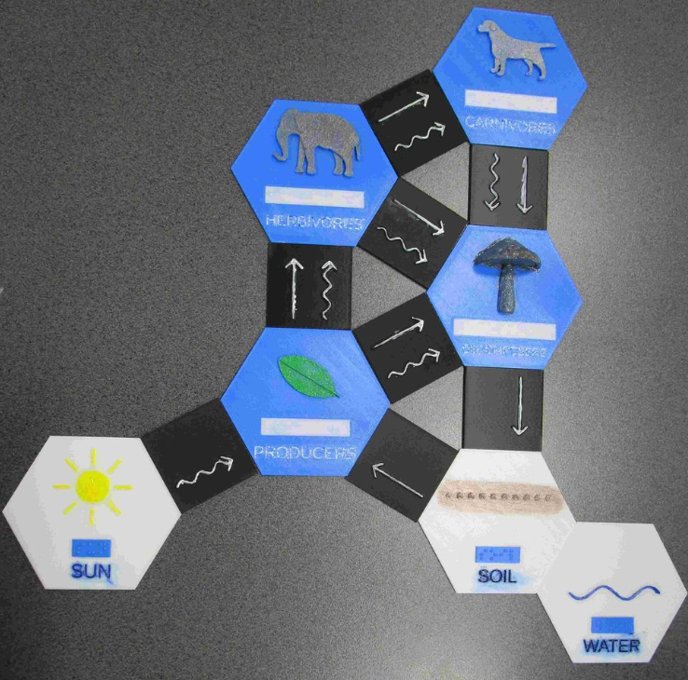
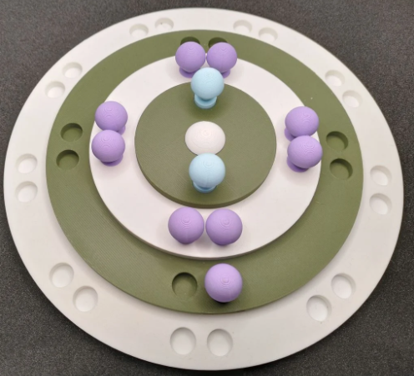
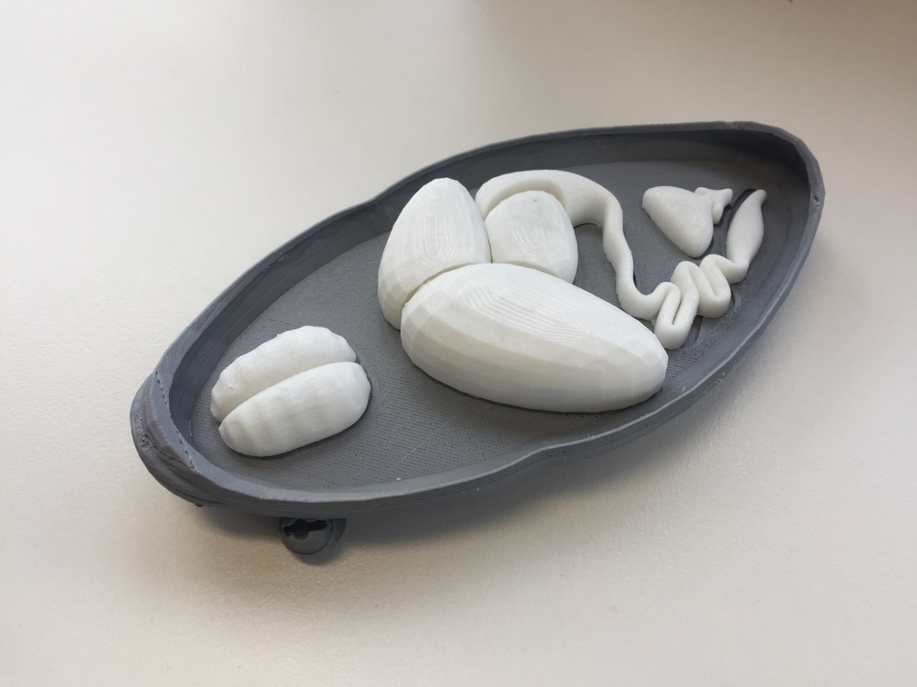
Bonus Content: 3D printing for the classroom
thing:6090007
thing:6090079
thing:6828617
thing:5782299
thing:6919532
frog dissection

Slide 27
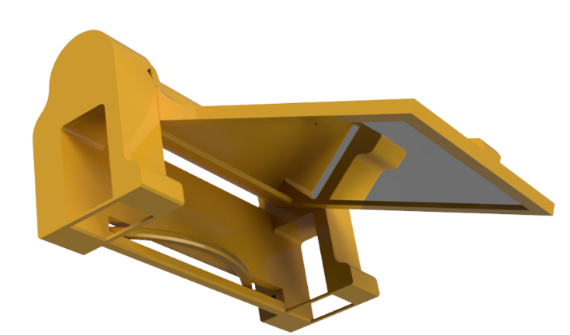
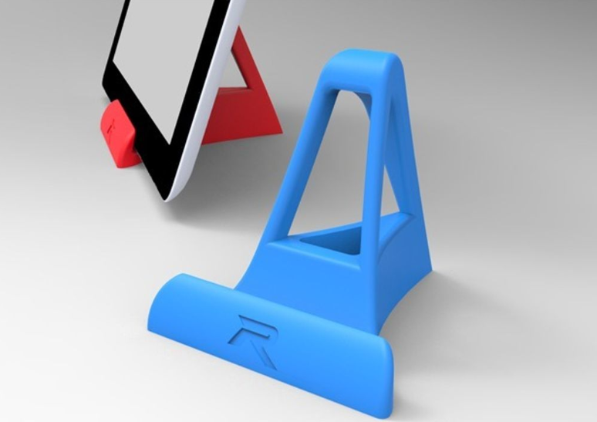
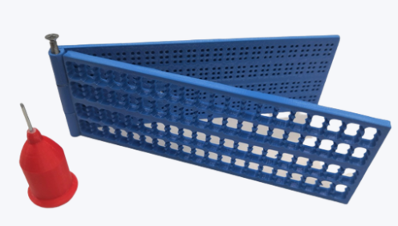
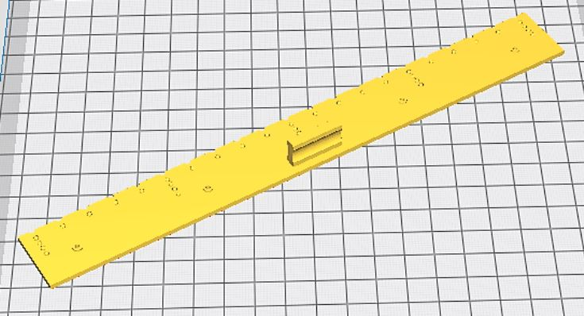
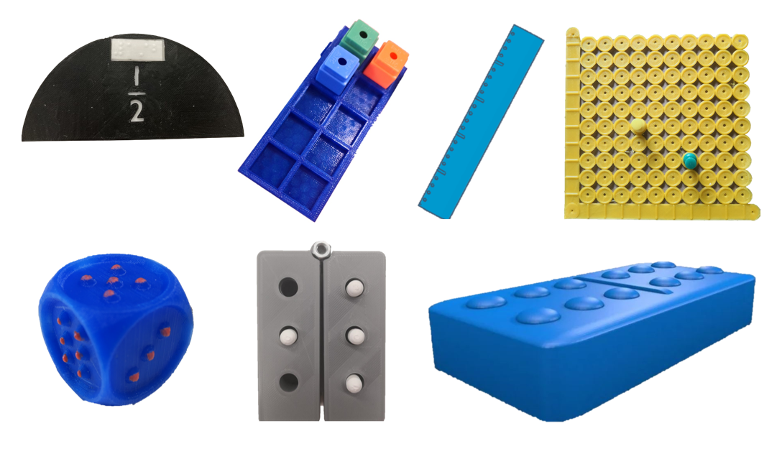
Bonus Content: 3D printing adaptive tools
thing:6767905
thing:4648088
thing:418533
thing:539591
3d augenbit
3d augenbit

Slide 28
Bonus Content: 3D printing guidelines
Round Table Guidelines for Producing Accessible 3D Prints
https://printdisability.org/guidelines/3d-prints/
Organisation support for 3D printing as an accessible format
When to use 3D printing for touch readers
Where to find pre-existing 3D models for printing
3D printing design software
Design considerations
The 3D printing process
Other methods for creating 3D models
Labelling 3D models
Finishing – Preparing 3D printed models for touch readers
Understanding 3D models through touch
3D printing on paper to create tactile graphics
Accessibility of 3D printing by people who are blind or have low vision

Slide 29
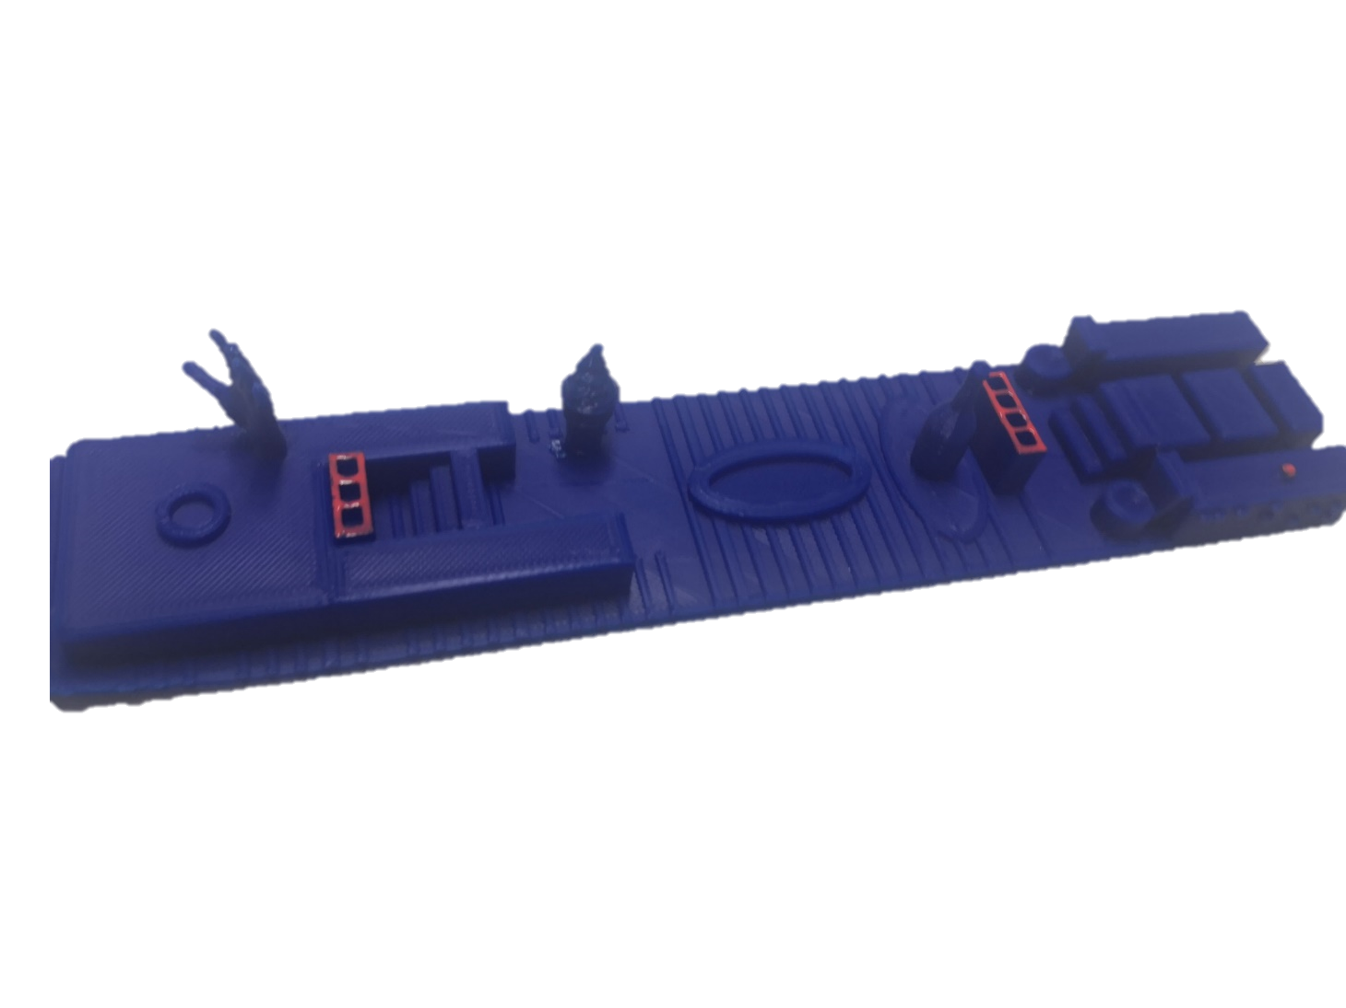
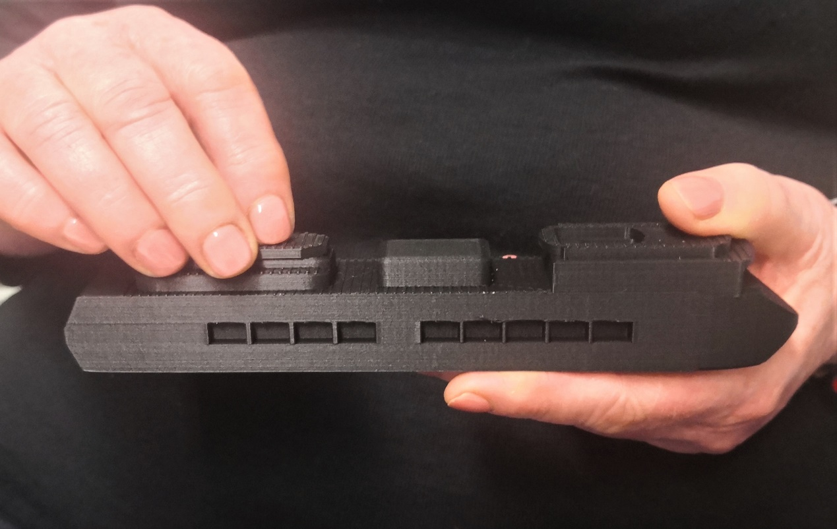
Bonus study: Personalised cruise ship map & model
Context
Solo travel on a large cruise ship with complex layout
Findings
More likely to take a 3D printed map with you because:
  It is robust
  It is appealing
Easier to understand complex multi-level layout
Stephens et al. “Smooth Sailing”, ASSETS 2020

